Slide 1
Face Recognition Tool for Social Network Analysis

Slide 2
Introduction
Welcome to the presentation on "Face Recognition Tool for Social Network Analysis."
In this presentation, we will introduce a tool that can analyze videos to identify faces, which can be valuable for social network analysis.

Slide 3
AGENDA
Introduction
Technologies Used
User Interface
Tool Workflow
Face Detection
Known Faces
PDF Report
Results
Saving the Report
Demonstration
Conclusion
Future Work
Questions
Thank You

Slide 4
For Law Enforcement Agencies:
Investigations: Law enforcement agencies can use the tool to aid in criminal investigations. It can help identify suspects, persons of interest, or witnesses in video evidence, facilitating the process of solving crimes.
Surveillance: The tool can be integrated into surveillance systems to monitor public spaces, events, and gatherings. Law enforcement can track and identify individuals of interest in real-time or from recorded video footage.
Access Control: It can be employed for access control and security applications. For example, it can verify the identity of individuals entering secure facilities or controlled areas by comparing faces to a database of authorized personnel.
Data Collection: In cases involving criminal networks or organized crime, the tool can assist in data collection by tracking individuals and their associations, aiding in the identification of key figures and networks.
accidents.
For Social Network Analysis (SNA):
User Profiling: The tool can assist in creating comprehensive user profiles by recognizing individuals in social media content. This is invaluable for SNA because it helps in understanding the composition of social networks, identifying key participants, and assessing their influence.
Behavior Analysis: By tracking faces in videos, SNA researchers can gain insights into user behaviors, interactions, and sentiments. For example, it can be used to study how individuals respond to content or to identify trends in user interactions within a network.
Influencer Identification: Identifying and recognizing key individuals or influencers in social networks is a crucial aspect of SNA. The tool can help in automatically identifying and tracking these influential figures, allowing for targeted analysis and engagement strategies.

Slide 5
Technologies Used
Our tool is built using a combination of powerful technologies and libraries, including:
PyQt5 for the graphical user interface.
OpenCV for video processing.
face_recognition for face detection and recognition.
ReportLab for generating PDF reports.

Slide 6
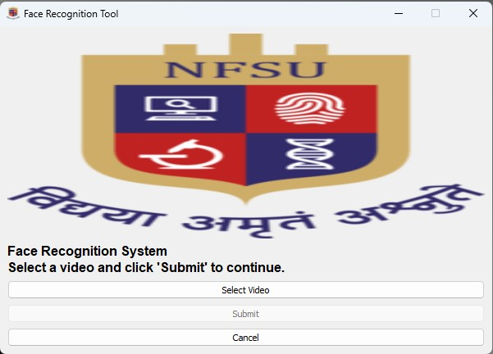
User Interface
The user interface is designed for simplicity and ease of use.
It includes the following elements:
"Select Video" button to choose a video for analysis.
"Submit" button to start processing the video.
"Cancel" button to exit the application.

Slide 7
Tool Workflow
Our tool follows a clear workflow:
Step 1: Select a video for analysis.
Step 2: Detect faces in the video frames.
Step 3: Compare detected faces to known faces.
Step 4: Generate a PDF report with matched faces and related text content.

Slide 8
Face Detection
We utilize OpenCV for face detection.
It identifies faces within video frames using a pre-trained model.
This initial step is crucial for subsequent recognition.

Slide 9
Known Faces
To recognize faces, we use a set of known faces.
These known faces are provided as images and serve as reference points.
The tool compares detected faces with these known faces for recognition.

Slide 10
PDF Report
After processing the video, our tool generates a PDF report.
The report includes matched faces and text content associated with those faces.
It provides a comprehensive summary of the analysis.

Slide 11
Results:
The tool yields valuable results, including:
Number of frames captured and saved in the output directory.
Count of faces detected and saved in the faces directory.
Details about matched faces found during the analysis.

Slide 12
Saving the Report:
Users have the option to save the generated PDF report to their preferred location.
This ensures that the analysis results are easily accessible for further study.

Slide 13
Demonstration:
Let's see the tool in action with a live demonstration using a sample video.

Slide 14
Conclusion:
In conclusion, our Face Recognition Tool for Social Network Analysis is a valuable resource.
It simplifies the process of analyzing videos for faces and enhances the efficiency of social network analysis.

Slide 15
Future Work
As we look to the future, there is potential for further improvement and expansion of the tool.
We welcome suggestions for additional features and enhancements.

Slide 16
THANK YOU

